Slide 1

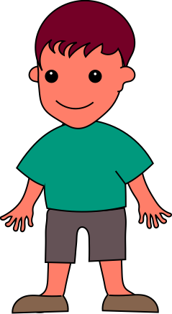
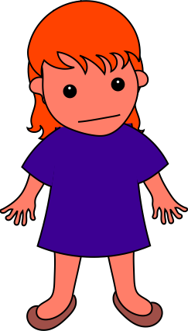

Graham gave Carol a gift.
Notes:
Joe wanted to learn Lucy's game. Joe said to Lucy, “Teach me how to play your game.”

Slide 2
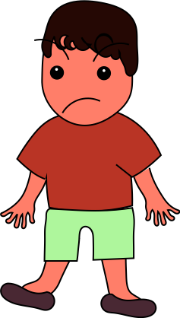
Drew kicked Carol.
Notes:
Sammy wanted to learn Lucy's game too. Sammy asked Lucy, “Can you teach me how to play your game?”

Slide 3
Remember, Graham gave her a gift. Drew kicked Carol. Which one was being meaner? Which one was being nicer?
Notes:
Sammy wanted to learn Lucy's game too. Sammy asked Lucy, “Can you teach me how to play your game?”

Slide 4

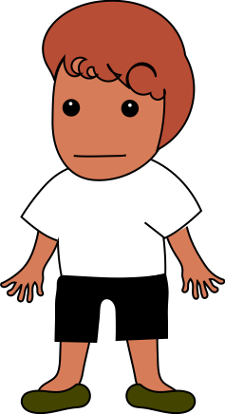
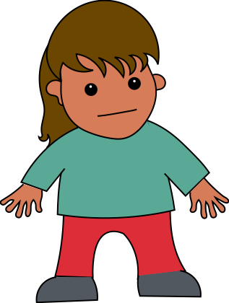

Johnny needed help with his puzzle. He said to Kate, “Help me with this puzzle”
Notes:
Scott needed help with his puzzle. Scott said to Kate, “Could you help me with this puzzle?”

Slide 5
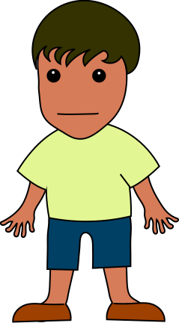
Scott also needed help with his puzzle. Scott said to Kate, “Could you help me with this puzzle?”
Notes:
Johnny also needed help with his puzzle. He said to Kate, “Help me with this puzzle”

Slide 6
Remember, Johnny said: "Help me with this puzzle." Scott said: "Could you help me with this puzzle?"
Which one was being more polite? Which one will Kate help with the puzzle?
Notes:
Remember, Scott said: "Could you help me with this puzzle?" Johnny said: "Help me with this puzzle."
Which one was being more polite? Which one would you rather play with?

Slide 7

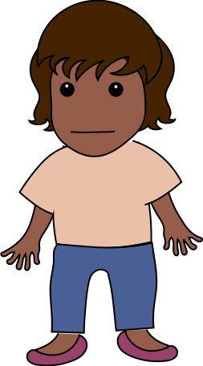
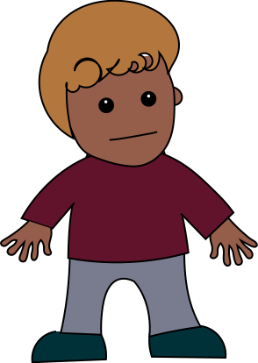
Zoe heard Miles shout. Zoe told him, ”Don’t shout.”
Notes:
Jenny heard Miles shout. Jenny told him, “Please don't shout.”

Slide 8
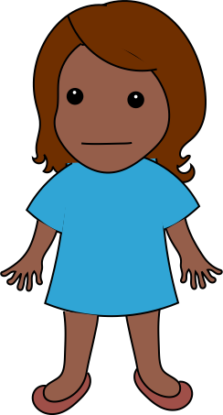
Jenny also heard Miles shout. Jenny told him, “Please don't shout.”
Notes:
Zoe also heard Miles shout. Zoe told him, ”Don’t shout.”

Slide 9
Remember, Zoe said: "Don't shout." Jenny said: "Please don't shout." Which one was being more rude? Which one would you rather play with?
Notes:
Which one was being more polite? Which one would you rather play with?

Slide 10

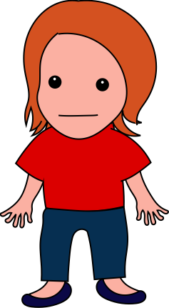
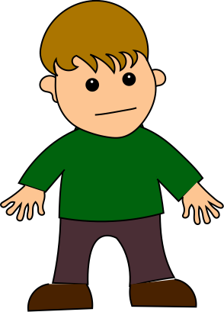
Tom was running inside the house. Amy said to him, “Could you stop running inside?”
Notes:
Tom was running inside the house. Marie said to him, ”Stop running inside.”

Slide 11
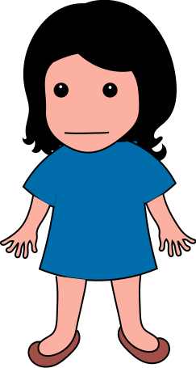
Tom was running inside the house again. Marie said to him, ”Stop running inside.”
Notes:
Tom was running inside the house again. Amy said to him, “Could you stop running inside?”

Slide 12
Remember, Amy said: "Could you stop running inside?" Marie said: "Stop running inside."
Which one was being meaner? Which one would you rather play with?
Notes:
Which one was being more polite? Which one would you rather play with?

Slide 13

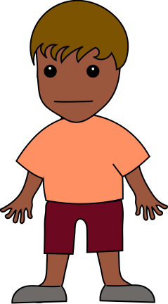
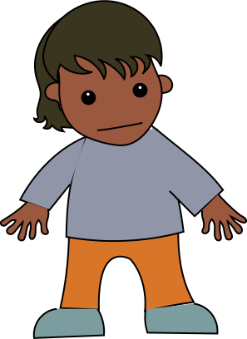

Ernie was hungry, so Ernie said to Alice, ”Give me more bread.”
Notes:
Claude was hungry, so Claude said to Alice, “Can you please give me more bread?”

Slide 14
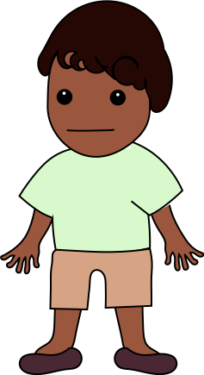
Claude was hungry too, so Claude said to Alice, “Can you please give me more bread?”
Notes:
Ernie was hungry too, so Ernie said to Alice, ”Give me more bread.”

Slide 15
Remember, Ernie said: "Give me more bread." Claude said: "Can you please give me more bread?"
Which one was being nicer? Which one would you rather play with?
Notes:
Which one was being nicer? Which one would you rather play with?

Slide 16
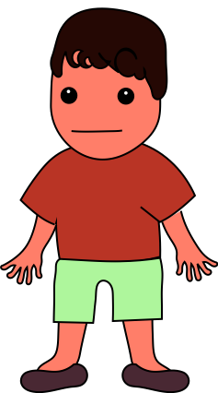

Sammy wanted to learn Lucy's game. Sammy asked Lucy, “Can you teach me how to play your game?”

Slide 17

Joe wanted to learn Lucy's game too. Joe said to Lucy, “Teach me how to play your game.”

Slide 18
Remember, Sammy said: "Can you teach me how to play your game?" Joe said: "Teach me how to play your game."
Which one was being more rude? Which one will Lucy teach about the game?

Slide 19

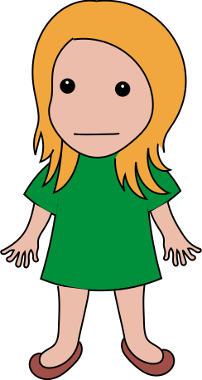
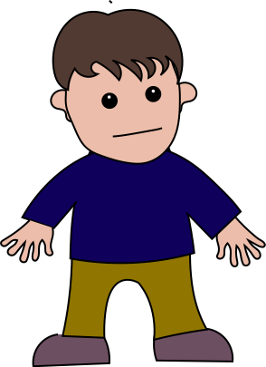

Mia wanted to use the scissors. Mia said to Chris, “Could you please hand me the scissors?”
Notes:
Jean wanted to use the scissors. Jean said to Chris, ”Hand me the scissors.”

Slide 20
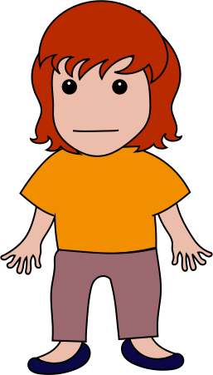
Jean also wanted to use the scissors. Jean said to Chris, ”Hand me the scissors.”
Notes:
Mia also wanted to use the scissors. Mia said to Chris, “Could you please hand me the scissors?”

Slide 21
Remember, Mia said: "Could you please hand me the scissors?" Jean said: "Hand me the scissors."
Which one was being more polite? Which one will Chris give the scissors to?
Notes:
Which one was being nicer? Which one would you rather play with?

Slide 22
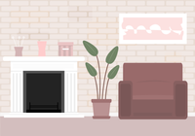


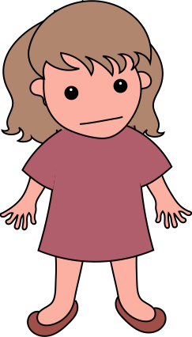
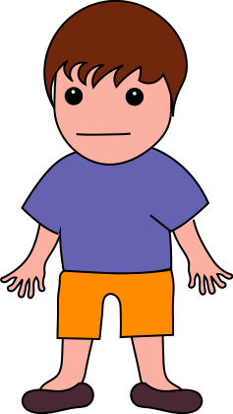

Andy didn’t like Kathy’s song. Andy said to her, “Could you please stop singing?”
Notes:
Josh didn’t like Kathy’s song. Josh said to her, ”Stop singing.”

Slide 23
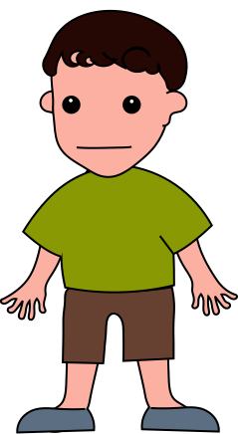
Josh didn’t like Kathy’s song either. Josh said to her, ”Stop singing.”
Notes:
Andy didn’t like Kathy’s song either. Andy said to her, “Could you please stop singing?”

Slide 24
Remember, Andy said: "Could you please stop singing?" Josh said: "Stop singing."
Which one was being more rude? Which one would you rather play with?
Notes:
Which one was being more polite? Which one would you rather play with?

Slide 25


Tasha had a bar of chocolate. Paul said to Tasha, “Give me some chocolate.”
Notes:
Tasha had a bar of chocolate. Louis said to Tasha, “Please give me some chocolate”

Slide 26
Louis said to Tasha, “Please give me some chocolate”
Notes:
Tasha had another bar of chocolate. Paul said to Tasha, “Give me some chocolate.”

Slide 27
Remember, Paul said: "Give me some chocolate." Louis said: "Please give me some chocolate."
Which one was being nicer? Which one will Tasha give chocolate to?
Notes:
Which one was being nicer? Which one would you rather play with?

Slide 28
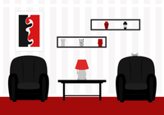
Ashley wanted someone to go to the store with. Ashley tells Simon, “Can you please come to the store with me?”
Notes:
Carla wanted someone to go to the store with. Carla tells Simon, ”Come to the store with me.”

Slide 29
Carla also wanted someone to go to the store with. Carla tells Simon, ”Come to the store with me.”
Notes:
Ashley also wanted someone to go to the store with. Ashley tells Simon, “Can you please come to the store with me?”

Slide 30
Remember, Ashley said: "Can you please come to the store with me?" Carla said: "Come to the store with me."
Which one was being meaner? Which one will Simon go to the store with?
Notes:
Which one was being more polite? Which one would you rather play with?

Slide 31
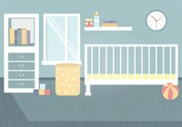
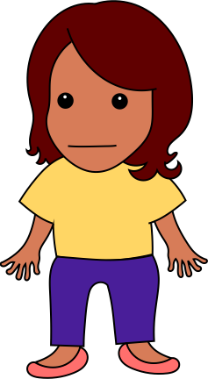
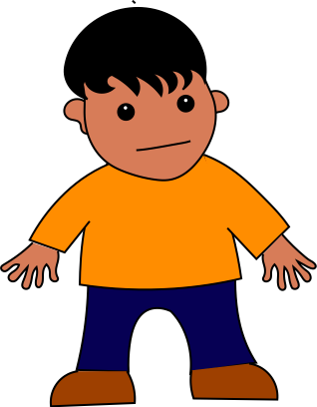


Millie thought Rick’s room was too messy. She told him, ”Pick up the toys.”
Notes:
Millie thought Rick’s room was too messy. She told him, ”Pick up the toys.”

Slide 32
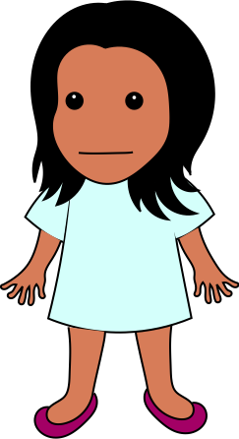
Franny also thought Rick’s room was too messy. She told him, “Can you pick up the toys?”
Notes:
Franny also thought Rick’s room was too messy. She told him, “Can you pick up the toys?”

Slide 33
Remember, Millie said: "Pick up the toys." Franny said: "Can you pick up the toys?"
Which one was being nicer? Which one would you rather play with?
Notes:
Which one was being nicer? Which one would you rather play with?

Slide 34



Suzy wanted more water in her cup. Suzy said to Fred, ”Pour me more water.”
Notes:
Jean wanted more water in her cup. Jean said to Fred, “Please pour me more water”

Slide 35
Jamie also wanted more water in her cup. Jamie said to Fred, “Please pour me more water”
Notes:
Suzy also wanted more water in her cup. Suzy said to Fred, ”Pour me more water.”

Slide 36
Remember, Suzy said: "Pour me more water." Jamie said: "Please pour me more water."
Which one was being meaner? Which one will Fred give water to?
Notes:
Which one was being nicer? Which one would you rather play with?

Slide 37
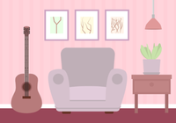

Anne was in a room where the lights were on. Bob doesn’t like bright lights, so he said, ”Turn off the light.”
Notes:
Anne was in a room where the lights were on. Greg doesn’t like bright lights, so he said, “please turn off the light.”

Slide 38
Greg also doesn’t like bright lights, so he said, “please turn off the light.”
Notes:
Bob also doesn’t like bright lights, so he said, ”Turn off the light.”

Slide 39
Remember, Bob said: "Turn off the light." Greg said: "please turn off the light."
Which one was being more polite? Which one would you rather play with?
Notes:
Which one was being more polite? Which one would you rather play with?

Slide 40
What do you think it means to be polite?
What do you think a polite person does?

Slide 41
The End!

